Slide 1

Bank Customer Segmentation
KANDACHARAM LIKHITHA
BATCH NO:403
Innomatics Research Labs, Dilshuknagar

Slide 2


Contents
Introduction
Problem Statement
Data Collection
Data Cleaning
Cleaned Data
Data Modeling
Measures Using DAX(Data Analysis Expressions)
Data Visualization
Insights
Conclusion

Slide 3

Introduction
The Bank Customer Segmentation project aims to analyze customer and transaction data using Power BI to help the bank make informed business decisions. It focuses on understanding customer demographics, spending behavior, and account activity. By applying RFM (Recency, Frequency, Monetary) analysis, customers are grouped into segments such as Loyal, New, and Lost. This helps the bank identify profitable customers, improve retention strategies, and manage risks effectively. The interactive dashboard provides meaningful insights that support better customer engagement and business growth.

Slide 4

Problem Statement
Banks collect a huge amount of customer and transaction data every day, but much of it is not properly used. The main problem is that the bank finds it difficult to understand customer behavior, know which customers are most valuable, and identify possible risks. Without these insights, it becomes hard to offer personalized services or make the right business decisions. This project helps solve these issues by using Power BI to analyze and visualize customer data, making it easier to segment customers and take smarter, data-based decisions.

Slide 5

Project Objectives
To understand customer details like age, gender, and location through clear visual analysis.
To study how customers spend and how their transactions change over time.
To divide customers into groups such as Loyal, New, and Lost using RFM analysis.
To find out which customers bring more profit and which ones may have higher risk.
To create an interactive Power BI dashboard that helps the bank make better and faster business decisions.

Slide 6
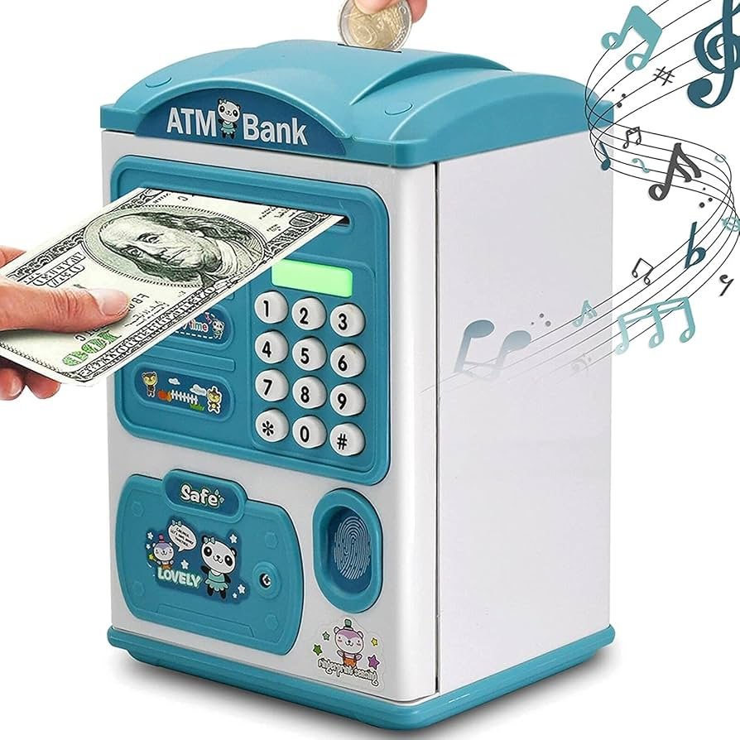
Collected Data
TransactionID – Unique ID assigned to each individual transaction.
CustomerID – Identifier linking each transaction to a specific customer.
CustomerDOB – Date of birth of the customer, useful for calculating age.
CustGender – Gender of the customer (e.g., Male, Female).
CustLocation – Geographic location or city of the customer.
CustAccountBalance – Account balance at the time of the transaction.
TransactionDate – The date when the transaction occurred.
TransactionTime – The exact time the transaction was executed.
TransactionAmount (INR) – The amount of money involved in the transaction in INR.

Slide 7
Steps for Collecting the Data
Identify Data Source:
The data was collected from the bank’s transaction system, which records customer and transaction details.
Select Required Fields:
Important columns like Customer ID, Date of Birth, Gender, Location, Account Balance, Transaction Date, Time, and Transaction Amount were chosen for analysis.
Export Data:
The selected data was exported from the system into a CSV (Comma-Separated Values) file for easy handling and sharing.
Verify Data Quality:
The CSV file was checked for missing values, incorrect formats, and duplicate records to ensure accuracy.
Load Data into Power BI:
The cleaned CSV file was imported into Power BI for transformation, visualization, and analysis.

Slide 8

Data Cleaning Steps
Removed duplicate records to keep only unique transactions.
Fixed wrong data types for date, time, and number columns.
Replaced missing or blank values with correct or default values.
Standardized gender names.
Converted date of birth into age and created age groups.
Checked for negative or invalid transaction amounts and corrected them.
Ensured all columns were clean and ready for analysis in Power BI.

Slide 9
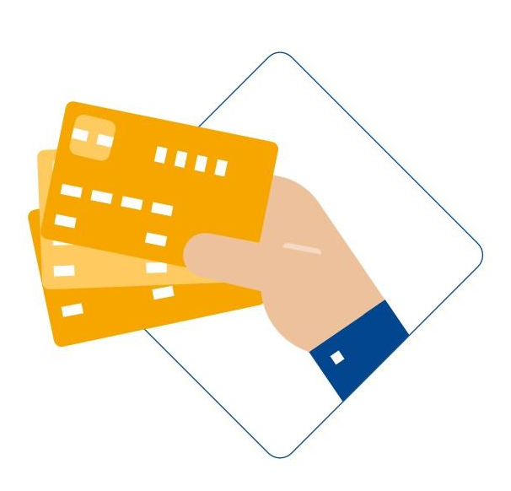
Data Modeling
A Customer_RFM table was created to store one record for each customer.
This table contains important details like RFM scores, customer segments, and risk levels.
A one-to-many relationship was made between the Customer_RFM table and the bank_transactions table using CustomerID.
This setup helps filter and view each customer’s complete transaction and financial details correctly in Power BI.

Slide 10
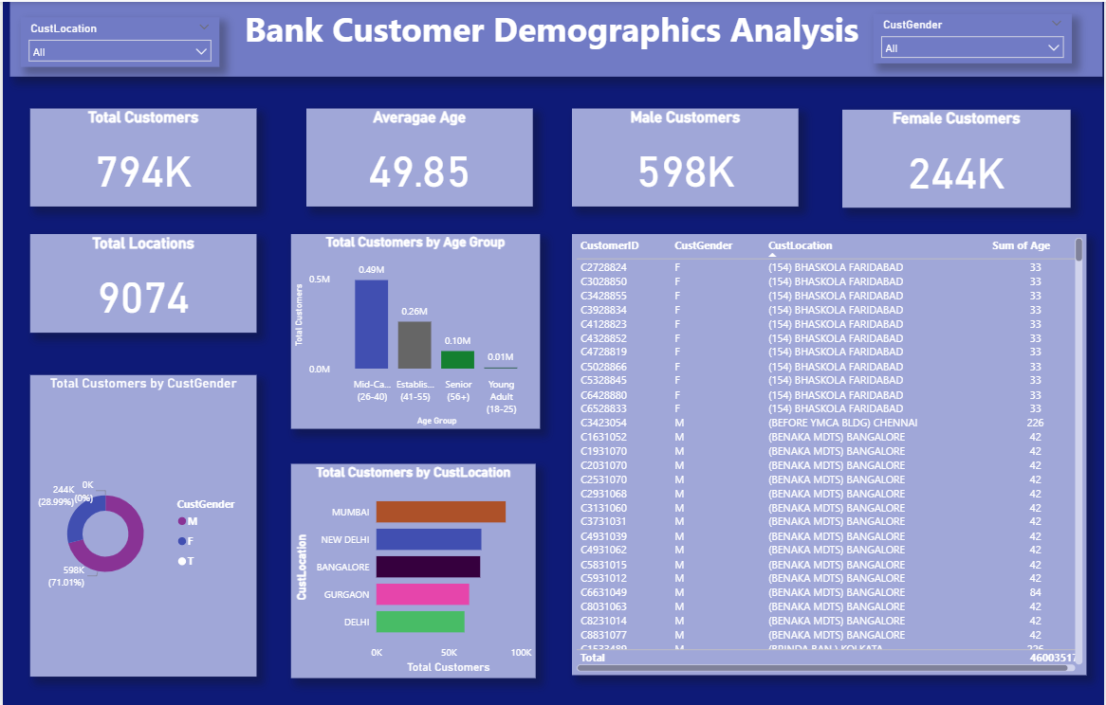

Slide 11
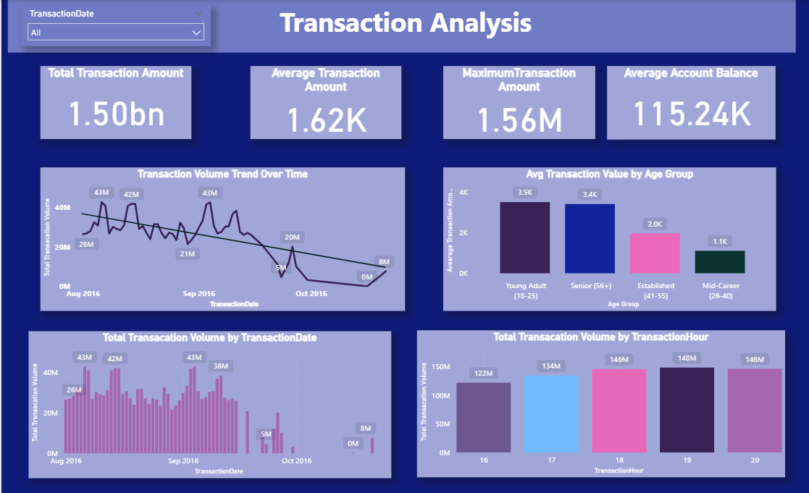

Slide 12
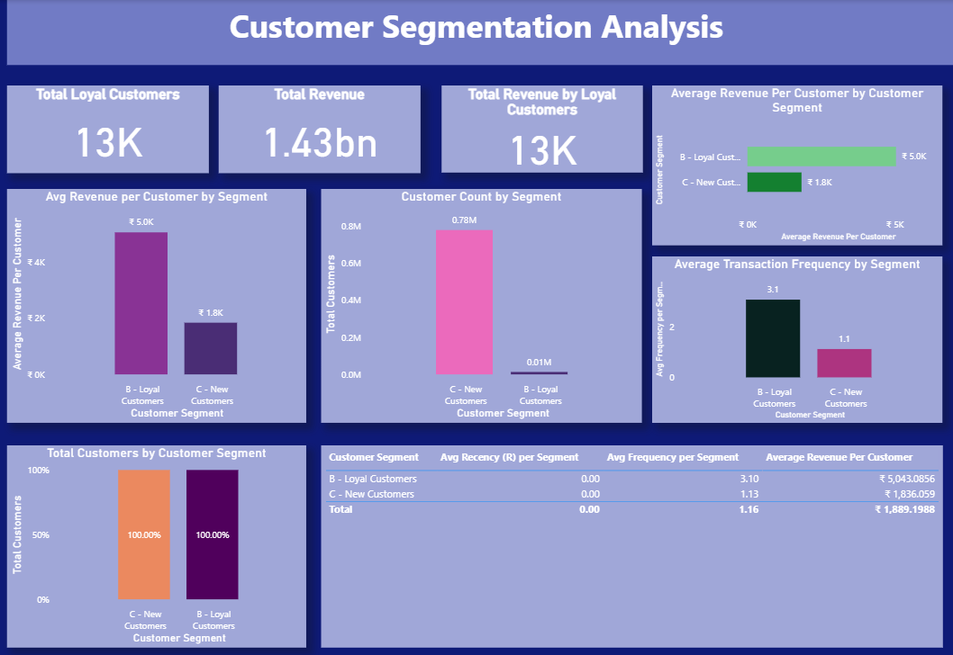

Slide 13
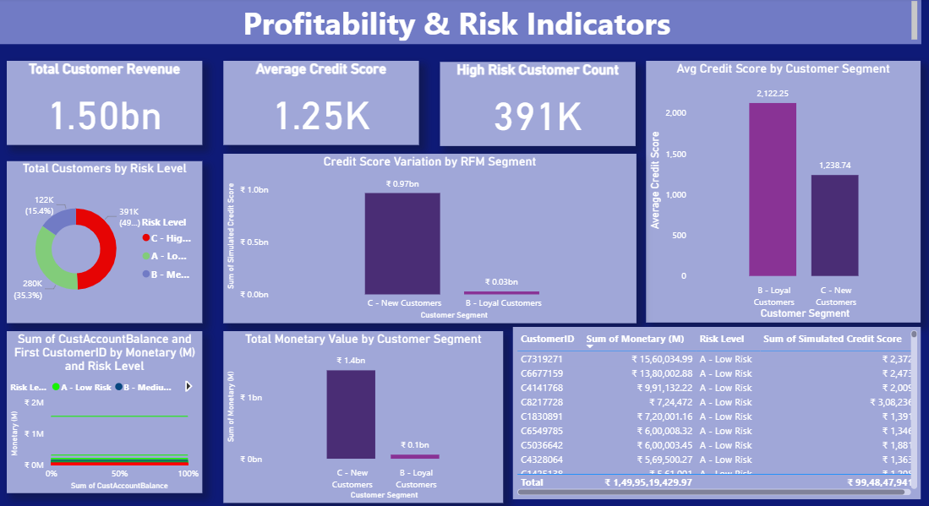

Slide 14
Insights
Champions Drive the Bank’s Revenue
The A – Champions group brings in the most money and uses the bank the most.
Focus: Give them exclusive rewards and keep them highly engaged.
Young Customers Dominate New Sign-ups
Most New Customers are in the 20–40 age group.
Focus: Use digital ads and youth-friendly campaigns to grow this segment faster.
Peak Activity Hours: 1 PM – 3 PM
The highest number of transactions happen in this two-hour window.
Focus: Avoid system maintenance and ensure full staff availability during this time.
Top Risk–Value Customers Identified
A clear list of the Top 10 high-revenue but high-risk customers is available.
Focus: Risk teams should review these customers immediately and set proper limits.
Hyderabad & Visakhapatnam Lead in Customer Volume
These two cities have the highest number of customers and revenue.
Focus: Direct marketing efforts, campaigns, and new branch planning to these locations.

Slide 15
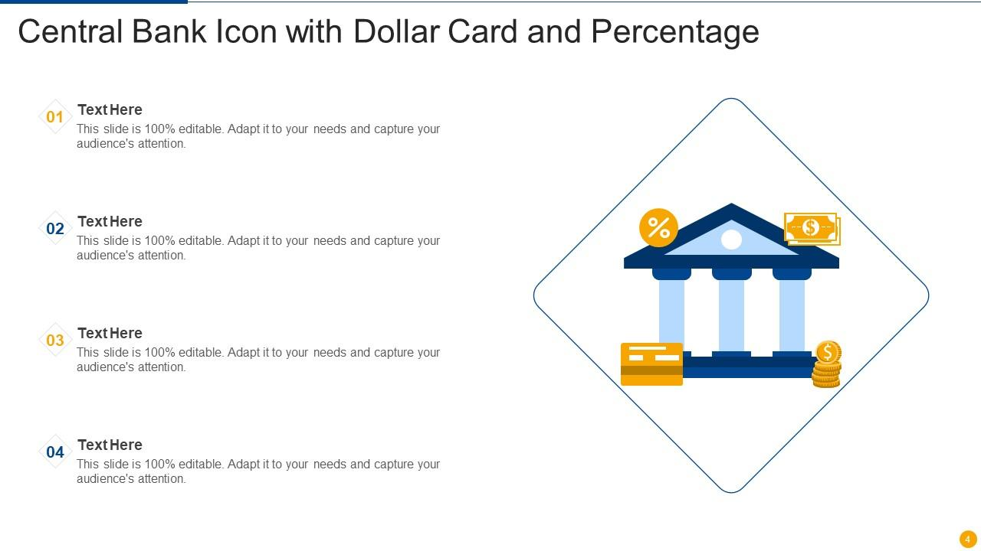
Conclusion
This project built a powerful and interactive Bank Customer Analytics system that goes far beyond basic reporting. Using RFM segmentation, we clearly identified our most valuable customers—especially the Champion and Loyal groups—allowing the bank to design highly personalized retention strategies.
We also added a Simulated Credit Score and Risk Level, giving the bank early visibility into potential financial risks, including the Top 10 high-revenue customers who also carry high risk.
Next, we’ll validate the RFM thresholds with experts, integrate the new Segment and Risk data into the CRM, and launch targeted campaigns using the demographic and behavioral insights from the dashboard.
This sets the stage for stronger customer loyalty and smarter risk management.

Slide 16


